Slide 1

Lincoln university
FACULTY OF ENGINEERING & BUILT Environment
Chapter 1: PN JUNCTION DEVICES
BY: MS. SOBRINA MOHAMAD SOBRI
ELECTRONIC DEVICES AND OPERATIONS 1

Slide 2
CONTENT
1.1 PN junction diode
1.2 Structure, operation and V-I characteristics
1.3 Diffusion and transient capacitance
1.4 Half Wave and Full Wave Rectifier
1.5 Display devices- LED, Laser diodes
1.6 Zener diode characteristics, Zener reverse characteristics
1.7 Zener as regulator

Slide 3
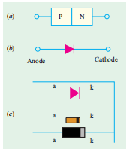
1.1 PN Junction Diode
Construction
It is a two-terminal device consisting of a P-N junction formed either in Ge or Si crystal.
Fig. (a) Circuit symbol, (b) Symbol of diode and (c) The picture of 2 commercial dioded.

Slide 4
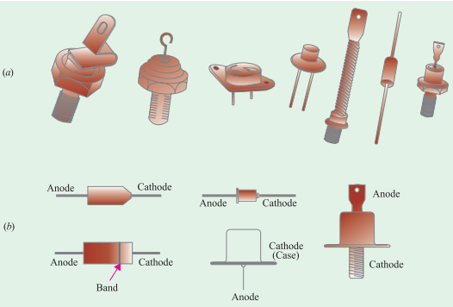
(a) shows typical diodes having a variety of physical structures whereas
(b) illustrates terminal identifications.
Notes:
Figure 1-1 Bohr Model

Slide 5
1. The low-current diodes whose body is about 3 mm long
- can carry a forward current of about 100 mA
- have saturation current of 5 µA at room temperature (25ºC)
- can withstand a reverse voltage of 75 V without breaking down.
2. The medium-current diodes
- can pass a forward current of about 500 mA
- can withstand a reverse voltage of 250 V
3. The high-current diodes or power diodes
- can pass a forward current of many amperes
- can survive several hundred volts of reverse voltage.

Slide 6


Diode Mounting
Low and medium-current diodes are usually mounted by soldering their leads to the connecting terminals.
The heat generated by these diodes (when operating) is small enough to be carried away by air convection and conduction along the connecting leads.
For cooling, they need heat sinks made of metals such as copper or aluminium which are good conductors of heat.
The sink absorbs heat from the device and then transfers it to the surrounding air by convection and radiation since it has large surface area.

Slide 7
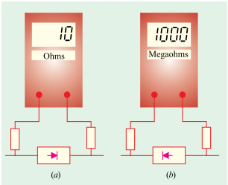
Working
A P-N junction diode is one-way device offering low resistance when forward-biased [Fig. (a)] and
behaving almost as an insulator when reverse-biased [Fig. (b)].
Hence, such diodes are mostly used as rectifiers i.e. for converting alternating current into direct current.

Slide 8
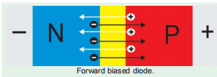
V/I Characteristic
Forward Characteristic
When the diode is forward-biased and the applied voltage is increased from zero,hardly any current flows through the device in the beginning.
It is so because the external voltage is being opposed by the internal barrier voltage VB whose value is 0.7 V for Si and 0.3 V for Ge.
As soon as VB is neutralized, current through the diode increases rapidly with increasing applied battery voltage.
It is found that as little a voltage as 1.0 V produces a forward current of about 50 mA.
A burnout is likely to occur if forward voltage is increased beyond a certain safe limit.

Slide 9

V/I Characteristic
Reverse Characteristic
When the diode is reverse-biased, majority carriers are blocked and only a small current (due to minority carriers) flows through the diode. As the reverse voltage is increased from zero, the reverse current very quickly reaches its maximum or saturation value I0 which is also known as leakage current. It is of the order of nanoamperes (nA) for Si and microamperes (µA) for Ge.

Slide 10
The value of I₀ (or I_{s} ) is independent of the applied reverse voltage but depends on (a) temperature, (b) degree of doping and (c) physical size of the junction.
As seen from Fig., when reverse voltage exceeds a certain value called break-down voltage VBR (or Zener voltage Vz), the leakage current suddenly and sharply increases, the curve indicating zero resistance at this point. Any further increase in voltage is likely to produce burnout unless protected by a current-limiting resistor.
When P-N junction diodes are employed primarily because of this breakdown property as voltage regulators, they are called Zener diodes (Art. 54.1).

Slide 11
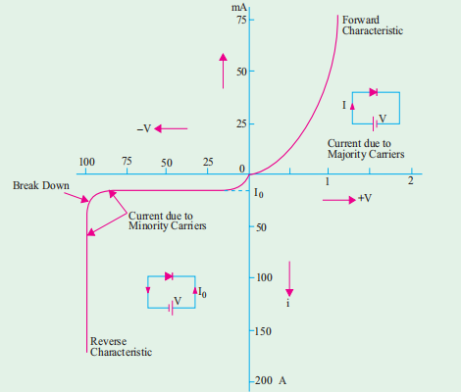
The volt-ampere characteristics described above are called static characteristics because they describe the d.c. behaviour of the diode. The forward and reverse characteristics have been combined into a single diagram of Fig. 52.4.
Notes:
Figure 1-1 Bohr Model

Slide 12
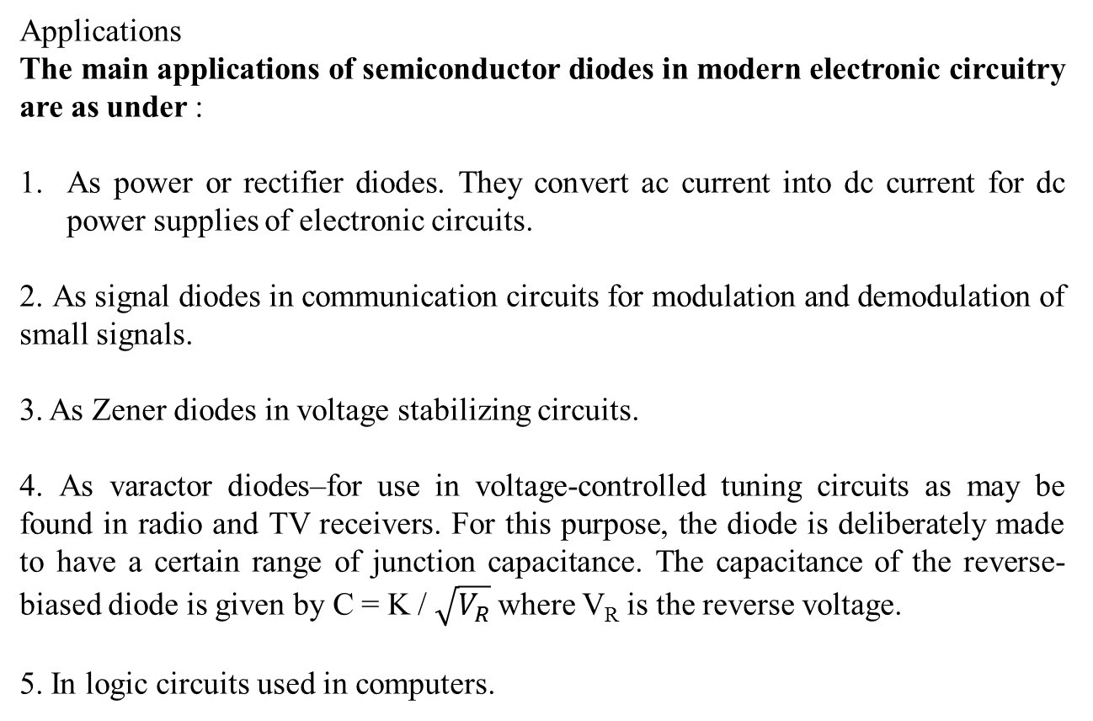
Applications
The main applications of semiconductor diodes in modern electronic circuitry are as under :
As power or rectifier diodes. They convert ac current into dc current for dc power supplies of electronic circuits.
2. As signal diodes in communication circuits for modulation and demodulation of small signals.
3. As Zener diodes in voltage stabilizing circuits.
4. As varactor diodes–for use in voltage-controlled tuning circuits as may be found in radio and TV receivers. For this purpose, the diode is deliberately made to have a certain range of junction capacitance. The capacitance of the reverse-biased diode is given by C = K / $\sqrt{V_{R}}$where V_{R} is the reverse voltage.
5. In logic circuits used in computers.

Slide 13
Junction Capacitance
Capacitive effects are exhibited by P-N junctions when they are either forward-biased or reverse biased.
(a) Transition Capacitance (CT) or Space-charge Capacitance
When a P-N junction is reverse-biased, the depletion region acts like an insulator or as a dielectric material essential for making a capacitor. The P- and N-type regions on either side have low resistance and act as the plates. We, therefore, have all the components necessary for making a parallel-plate capacitor. This junction capacitance is called transition or space charge capacitance (C_{pn} or C_{T}).

Slide 14
(b) Diffusion or Storage Capacitance (CD)
This capacitive effect is present when the junction is forward-biased. It is called diffusion capacitance to account for the time delay in moving charges across the junction by diffusion process.* Due to this fact, this capacitance cannot be identified in terms of a dielectric and plates. It varies directly with the magnitude of forward current as explained below in more details.

Slide 15
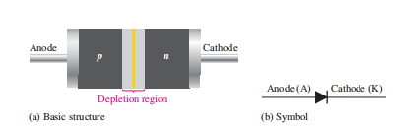
DIODE
Diode is a two-terminal semiconductor device formed by two doped regions of silicon separated by a pn junction.
The p region is called the anode and is connected to a conductive terminal.
The n region is called the cathode and is connected to a second conductive terminal. The basic diode structure and schematic symbol are shown in Figure below.

Slide 16
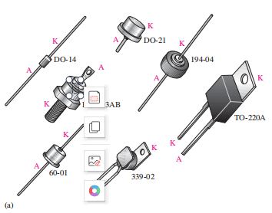
Typical Diode PAckages
Several common physical configurations of through-hole mounted diodes are shown as in Figure (a).
The cathode is usually marked by a band, a tab or some other feature.
On those packages where one lead is connected to the case, the case is cathode.

Slide 17
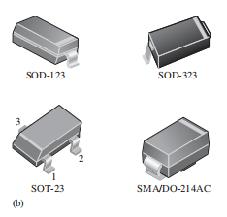
Surface-Mount Diode Packages
Figure (b) shows typical diode packages for surface mounting on a printed circuit board.
The SOD and SMA types have a band on one end to indicate the cathode.
The SOT type is a three-terminal package in which there are either one or two diodes.
In a single-diode SOT package, pin 1 is usually the anode and pin 3 is the cathode.
In a dual-diode SOT package, pin 3 is the common terminal and can be either the anode or the cathode.
Note: Always check the datasheet for the particular diode to verify the pin configurations.

Slide 18
Forward Bias
Note: Biasing is the setting of initial operating conditions of an active device in an amplifier, require a steady current or voltage at their terminals to operate correctly.
Forward bias is the condition that allows current through the pn junction.

Slide 19
Reverse Bias
Note: Biasing is the setting of initial operating conditions of an active device in an amplifier, require a steady current or voltage at their terminals to operate correctly.
Reverse bias is the condition that essentially prevents current through the diode.

Slide 20
Reverse Breakdown
Normally, the reverse current is so small that it can be neglected.
However, if the external reverse-bias voltage is increased to a value called the breakdown voltage, the reverse current will drastically increase. This is what happens.
The current can increase dramatically if steps are not taken to limit the current.
When the reverse current is not limited, the resulting heating will permanently damage the diode.
Most diodes are not operated in reverse breakdown, but if the current is limited (by adding a series-limiting resistor for example), there is no permanent damage to the diode.

Slide 21
Diode Models

Slide 22
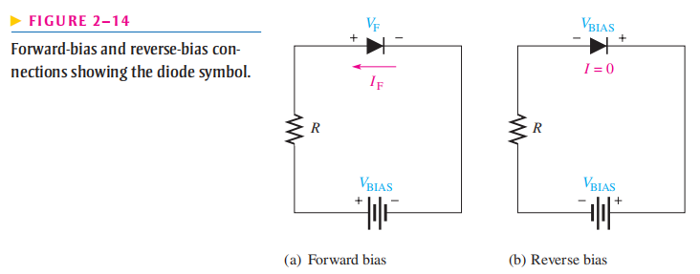
Bias connection
Forward-Bias Recall that a diode is forward-biased when a voltage source is connected as shown in Figure 2–14(a). The positive terminal of the source is connected to the anode through a current-limiting resistor. The negative terminal of the source is connected to the cathode. The forward current (I_{F}) is from cathode to anode as indicated. The forward voltage drop (V_{F}) due to the barrier potential is from positive at the anode to negative at the cathode.
Reverse-Bias Connection A diode is reverse-biased when a voltage source is connected as shown in Figure 2–14(b). The negative terminal of the source is connected to the anode side of the circuit, and the positive terminal is connected to the cathode side. A resistor is not necessary in reverse bias but it is shown for circuit consistency. The reverse current is
extremely small and can be considered to be zero. Notice that the entire bias voltage (V_{BIAS}) appears across the diode.

Slide 23
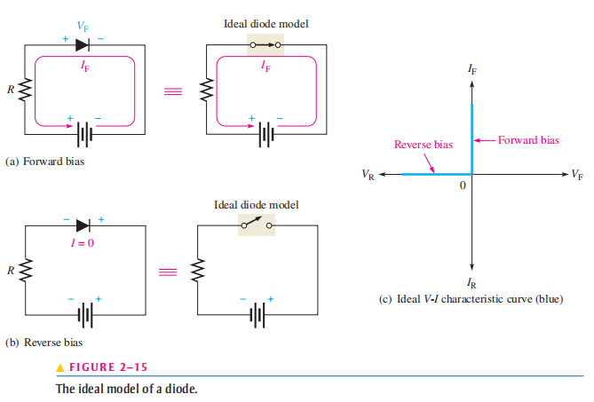
Diode Approximation
1. Ideal Diode Model
The ideal model of a diode is the least accurate approximation and can be represented by a simple switch.
When the diode is forward-biased, it ideally acts like a closed (on) switch, as shown in Figure 2–15(a).
When the diode is reverse-biased, it ideally acts like an open (off) switch, as shown in part (b).

Slide 24
In Figure 2–15(c), the ideal V-I characteristic curve graphically depicts the ideal diode operation.
Since the barrier potential and the forward dynamic resistance are neglected, the diode is assumed to have a zero voltage across it when forward-biased;
V_{F} = 0 V
The forward current is determined by the bias voltage and the limiting resistor using Ohm’s law.
I_{F} = V_{BIAS} / R_{LIMIT}
Since the reverse current is neglected, its value is assumed to be zero;
I_{R} = 0 V
The reverse voltage equals the bias voltage.
V_{R} = V_{BIAS}
Note: The ideal model is useful when you are troubleshooting or trying to figure out the operation of a circuit and are not concerned with more exact values of voltage or current.

Slide 25
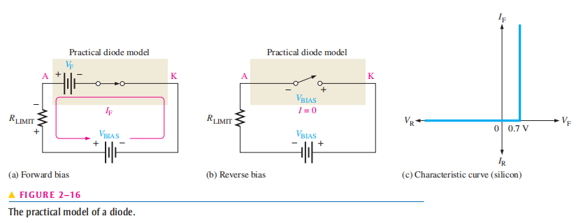
2. Practical Diode Model
The practical model includes the barrier potential.
When the diode is forward-biased, it is equivalent to a closed switch in series with a small equivalent voltage source (V_{F}) equal to the barrier potential (0.7 V) with the positive side toward the anode, as indicated in Figure 2–16(a).
This equivalent voltage source represents the barrier potential that must be exceeded by the bias voltage before the diode will conduct and is not an active source of voltage.
When conducting, a voltage drop of 0.7 V appears across the diode.
When the diode is reverse-biased, it is equivalent to an open switch just as in the ideal model, as shown in Figure 2–16(b). The barrier potential does not affect reverse bias, so it is not a factor.

Slide 26


The characteristic curve for the practical diode model is shown in Figure 2–16(c).
Since the barrier potential is included and the dynamic resistance is neglected, the diode is assumed to have a voltage across it when forward-biased, as indicated by the portion of the curve to the right of the origin.
V_{F} = 0.7 V
The forward current is determined as follows by first applying Kirchhoff’s voltage law to
The diode is assumed to have zero reverse current, as indicated by the portion of the curve on the negative horizontal axis.
Note: The practical model is useful when you are troubleshooting in lower-voltage circuits. In these cases, the 0.7 V drop across the diode may be significant and should be taken into account. The practical model is also useful when you are designing basic diode circuits.

Slide 27
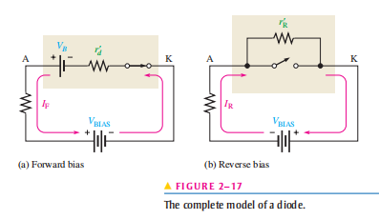
2. Complete Diode Model
The complete model of a diode is the most accurate approximation and includes the barrier potential, the small forward dynamic resistance (r’_{d}) and the large internal reverse resistance (r’_{R})
The reverse resistance is taken into account because it provides a path for the reverse current, which is included in this diode model.
When the diode is forward-biased, it acts as a closed switch in series with the equivalent barrier potential voltage (V_{B}) and the small forward dynamic resistance r’_{d} as indicated in Figure 2–17(a).
When the diode is reverse-biased, it acts as an open switch in parallel with the large internal reverse resistance r’_{R} as shown in Figure 2–17(b).
The barrier potential does not affect reverse bias, so it is not a factor.

Slide 28
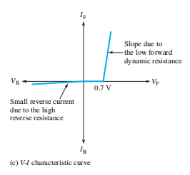

Note: The complete model is suited to design problems using a computer for simulation. For troubleshooting work, it is unnecessary to use the complete model, as it involves complicated calculations.

Slide 29
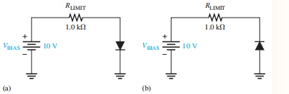
Example:
(a) Determine
i. forward voltage
ii. forward current
iii. voltage across the limiting resistor
in Figure (a) for each of the diode models. Assume r’_{d} = 10 Ω at the determined value of forward current.
(b) Determine
i. reverse voltage
ii. reverse current
iii. voltage across the limiting resistor
in Figure (b) for each of the diode models. Assume I_{R} = 1 µA.

Slide 30
Half-Wave Rectifiers

Slide 31
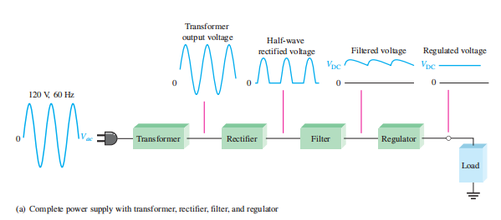
The Basic DC Power Supply

Slide 32
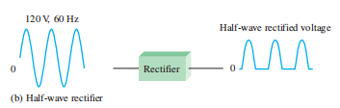
The rectifier converts the ac input voltage to a pulsating dc
voltage, called a half-wave rectified voltage.

Slide 33
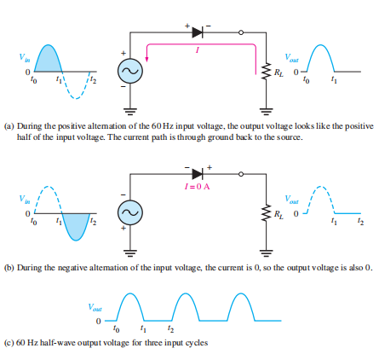
Half-Wave Rectifier Operation
A diode is connected to an ac source and to a load resistor, R_{L}, forming a half-wave rectifier.
During positive half cycle:
The diode is forward-biased and conducts current through the load resistor, as shown in part (a). The current produces an output voltage across the load R_{L}, which has the same shape as the positive half-cycle of the input voltage.
During negative half cycle:
The diode is reverse-biased. There is no current, so the voltage across the load resistor is 0 V, as shown in Figure 2–20(b).

Slide 34
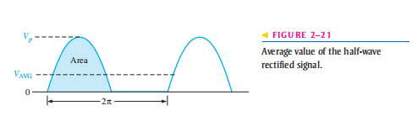

Average Value of the Half-Wave Output Voltage
Where;
V_{p} is the peak value of the voltage

Slide 35
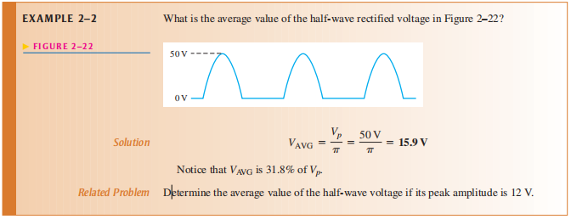

Slide 36
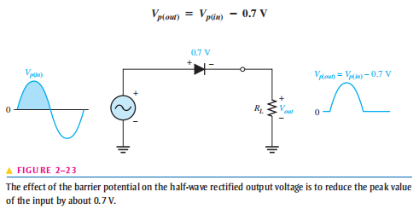
Effect of the Barrier Potential on the Half-Wave Rectifier Output
During the positive half-cycle, the input voltage must overcome the barrier potential before the diode becomes forward-biased.

Slide 37
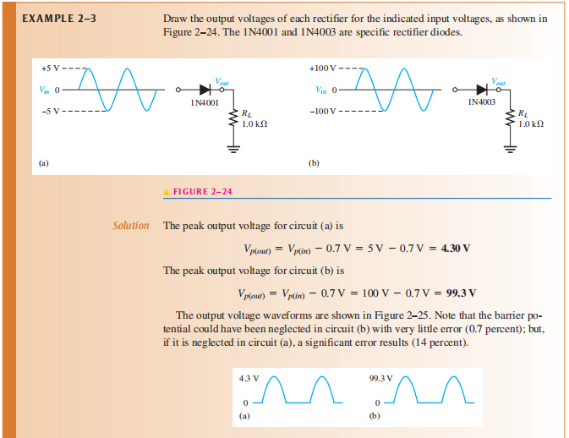

Slide 38
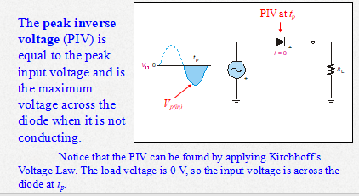
Peak Inverse Voltage (PIV)
PIV = V_{p(in)}

Slide 39
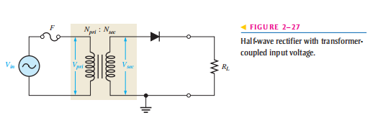
Transformer Coupling
A transformer is often used to couple the ac input voltage from the source to the rectifier, as shown in Figure 2–27.
Transformer coupling provides two advantages.
1. It allows the source voltage to be stepped down as needed.
2. Second, the ac source is electrically isolated from the rectifier, thus preventing a shock hazard in the secondary circuit.

Slide 40
V_{sec} = nV_{pri}
If;
n > 1 : the secondary voltage is greater than the primary voltage
n < 1 : the secondary voltage is less than the primary voltage
n = 1 : V_{sec} = V_{pri}
V_{p(out)} = V_{p(sec)} - 0.7 V
PIV = V_{p(sec)}

Slide 41
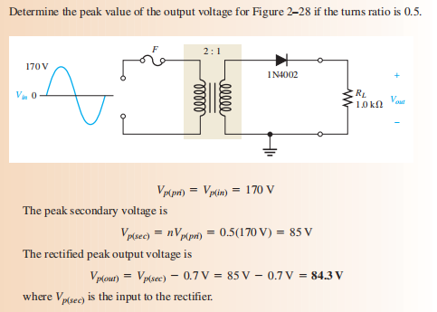

Slide 42
Full-Wave Rectifiers

Slide 43
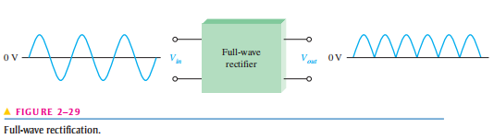
A full-wave rectifier allows unidirectional (one-way) current through the load during the entire of the input cycle, whereas a half-wave rectifier allows current through the load only during one-half of the cycle.
The result of full-wave rectification is an output voltage with a frequency twice the input frequency and that pulsates every half-cycle of the input, as shown in Figure 2–29.

Slide 44

The average value for a full-wave rectified sinusoidal voltage is twice that of the half-wave, as shown in the following formula:
VAVG is approximately 63.7% of V_{p} for a full-wave rectified voltage.

Slide 45
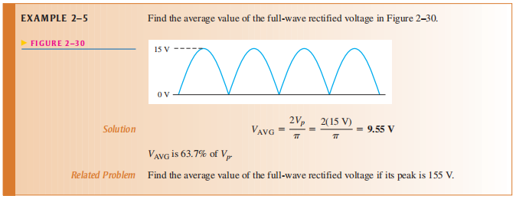

Slide 46
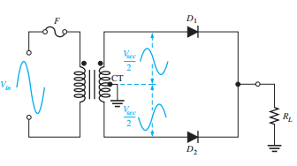
Center-Tapped Full-Wave Rectifier Operation
A center-tapped rectifier is a type of full-wave rectifier that uses two diodes connected to the secondary of a center-tapped transformer, as shown in Figure 2–31.

Slide 47
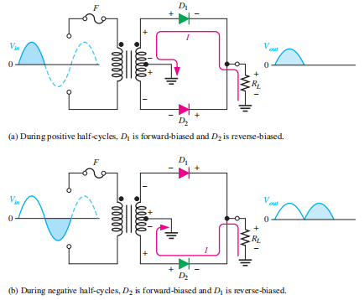
Basic operation of a center-tapped full-wave rectifier.
For a positive half-cycle of the input voltage; This condition forward-biases diode D1 and reverse-biases diode D2.
For a negative half-cycle of the input voltage; This condition reverse-biases D1 and forward-biases D2
Because the output current during both the positive and negative portions of the input cycle is in the same direction through the load, the output voltage developed across the load resistor is a full-wave rectified dc voltage, as shown.

Slide 48
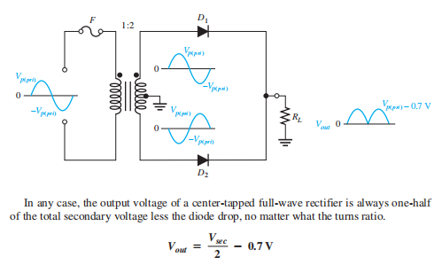
Effect of the Turns Ratio on the Output Voltage

Slide 49
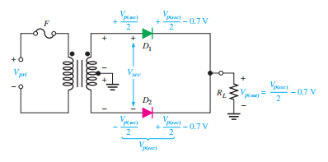
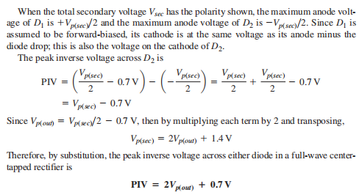
Peak Inverse Voltage

Slide 50
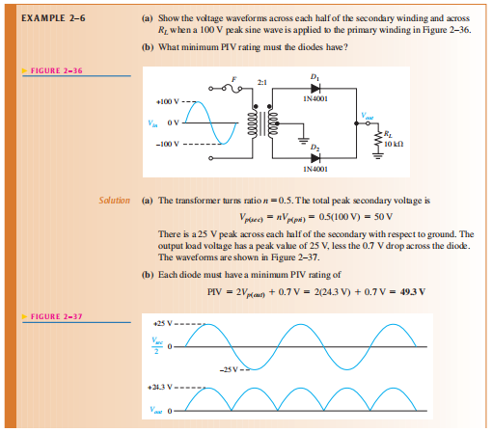

Slide 51
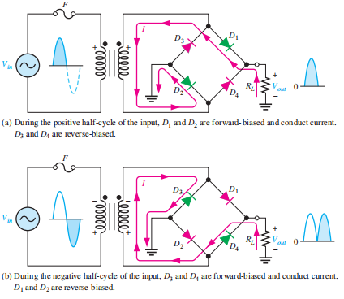
Bridge Full-Wave Rectifier Operation
The bridge rectifier uses four diodes connected.
When the input cycle is positive as in part (a), diodes D1 and D2 are forward-biased and conduct current in the direction shown. A voltage is developed across RL that looks like the positive half of the input cycle. During this time, diodes D3 and D4 are reverse-biased.
When the input cycle is negative as in part (b), diodes D3 and D4 are forward biased and conduct current in the same direction through RL as during the positive half-cycle. During the negative half-cycle, D1 and D2 are reverse-biased.

Slide 52
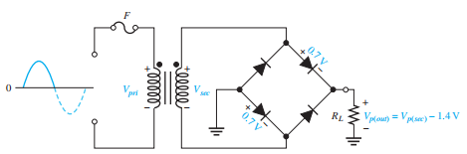

Bridge Output Voltage

Slide 53
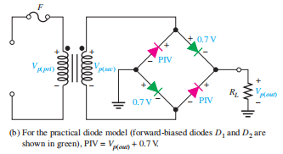
Peak Inverse Voltage

Slide 54
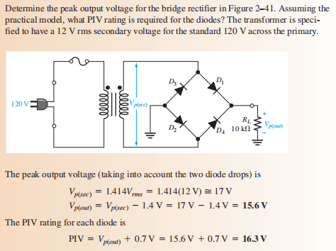

Slide 55
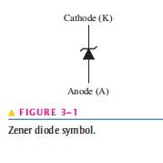
Zener Diode
The symbol for a zener diode is shown in Figure 3–1. Instead of a straight line representing the cathode, the zener diode has a bent line that reminds you of the letter Z (for zener).
A zener diode is a silicon pn junction device that is designed for operation in the reverse-breakdown region.
The breakdown voltage of a zener diode is set by carefully controlling the doping level during manufacture.

Slide 56
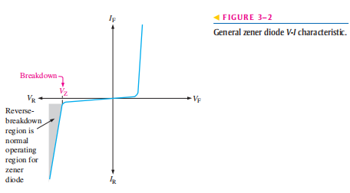
This volt-ampere characteristic is shown again in Figure 3–2 with
the normal operating region for zener diodes shown as a shaded area.

Slide 57
Zener Breakdown
Zener diodes are designed to operate in reverse breakdown.
Two types of reverse breakdown in a zener diode are avalanche and zener.
Zener breakdown occurs in a zener diode at low reverse voltages.
A zener diode is heavily doped to reduce the breakdown voltage.
This causes a very thin depletion region.
As a result, an intense electric field exists within the depletion region.
Near the zener breakdown voltage (VZ), the field is intense enough to pull electrons from their valence bands and create current.

Slide 58
Zener diodes with breakdown voltages of less than approximately 5 V operate predominately in zener breakdown.
Those with breakdown voltages greater than approximately 5 V operate predominately in avalanche breakdown.
Both types, however, are called zener diodes. Zeners are commercially available with breakdown voltages from less than 1 V to more than 250 V with specified tolerances from 1% to 20%.

Slide 59
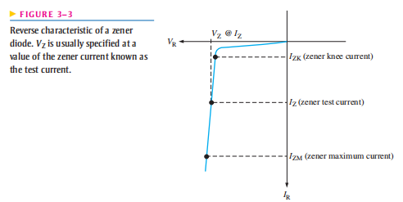
Breakdown Characteristics
Figure 3–3 shows the reverse portion of a zener diode’s characteristic curve.
Notice that as the reverse voltage (VR) is increased, the reverse current (IR) remains extremely small up to the “knee” of the curve.
The reverse current is also called the zener current, IZ.
At this point, the breakdown effect begins; the internal zener resistance, also called zener impedance (ZZ), begins to decrease as the reverse current increases rapidly.
From the bottom of the knee, the zener breakdown voltage (VZ) remains essentially constant although it increases slightly as the zener current, IZ, increases.

Slide 60
Zener Regulation
The ability to keep the reverse voltage across its terminals essentially constant is the key feature of the zener diode.
A zener diode operating in breakdown acts as a voltage regulator because it maintains a nearly constant voltage across its terminals over a specified range of reverse-current values.
A minimum value of reverse current, IZK, must be maintained in order to keep the diode in breakdown for voltage regulation.
The curve in Figure 3–3 that when the reverse current is reduced below the knee of the curve, the voltage decreases drastically, and regulation is lost.
Also, there is a maximum current, IZM, above which the diode may be damaged due to excessive power dissipation.
So, basically, the zener diode maintains a nearly constant voltage across its terminals for values of reverse current ranging from IZK to IZM.
A nominal zener voltage, VZ, is usually specified on a datasheet at a value of reverse current called the zener test current.

Slide 61
Zener Diode Applications
Zener Regulation with a Variable Input Voltage
Zener diode regulators can provide a reasonably constant dc level at the output, but they are not particularly efficient.
For this reason, they are limited to applications that require only low current to the load.
Figure 3–9 illustrates how a zener diode can be used to regulate a dc voltage.

Slide 62
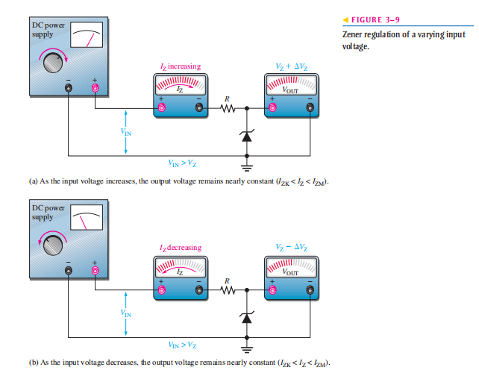

Slide 63
As the input voltage varies (within limits), the zener diode maintains a nearly constant output voltage across its terminals.
However, as VIN changes, IZ will change proportionally so that the limitations on the input voltage variation are set by the minimum and maximum current values (IZK and IZM) with which the zener can operate.
Resistor R is the series current-limiting resistor.
The meters indicate the relative values and trends.

Slide 64
To illustrate regulation, let’s use the ideal model of the 1N4740A zener diode (ignoring the zener resistance) in the circuit of Figure 3–10.
The absolute lowest current that will maintain regulation is specified at which for the 1N4740A is 0.25 mA and represents the no-load current.
The maximum current is not given on the datasheet but can be calculated from the power specification of 1 W, which is given on the datasheet.
Keep in mind that both the minimum and maximum values are at the operating extremes and represent worst-case operation.

Slide 65
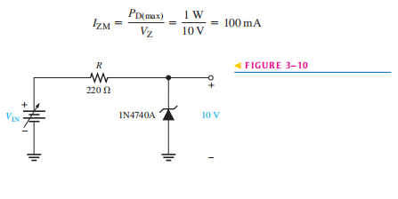

Slide 66
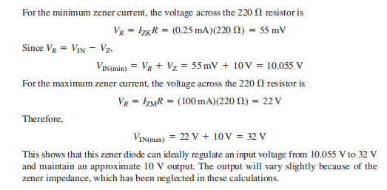

Slide 67
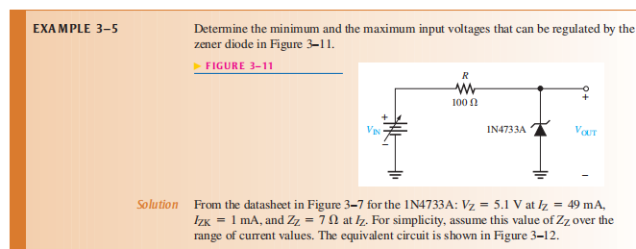

Slide 68
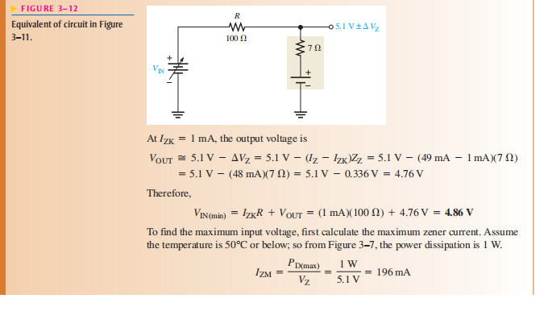

Slide 69
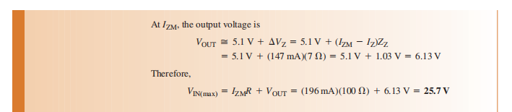

Slide 70
Thank you..

